Slide 1

GASTech Missing Employees (Term Project 2)
By Simran Kota and Arun Joseph

Slide 2
Situation
GAStech operates a natural gas production site on the island of Kronos
Company just completed a successful IPO
Several employees go missing – suspected terrorist organization (Protectors of Kronos POK) is behind it
Task: Identify suspicious patterns of behavior that may be related to the missing staff members

Slide 3
The Data
Abila roadmap shape file & Map of Abila
Car GPS data
Company cars can be used for both personal and business use
Company trucks cannot be used for personal business
Cars have geospatial tracking for 2 weeks prior to the disappearance
Credit/Debit card transactions
Loyalty card transactions

Slide 4
Assumptions
Suspected members of POK include GAStech employees on Kronos Island
The only employees that are not assigned a car are truck drivers
Employees are not aware of the tracking device on their vehicles and do NOT share vehicles
Provided map has the names and locations of ALL businesses involved in the investigation

Slide 5
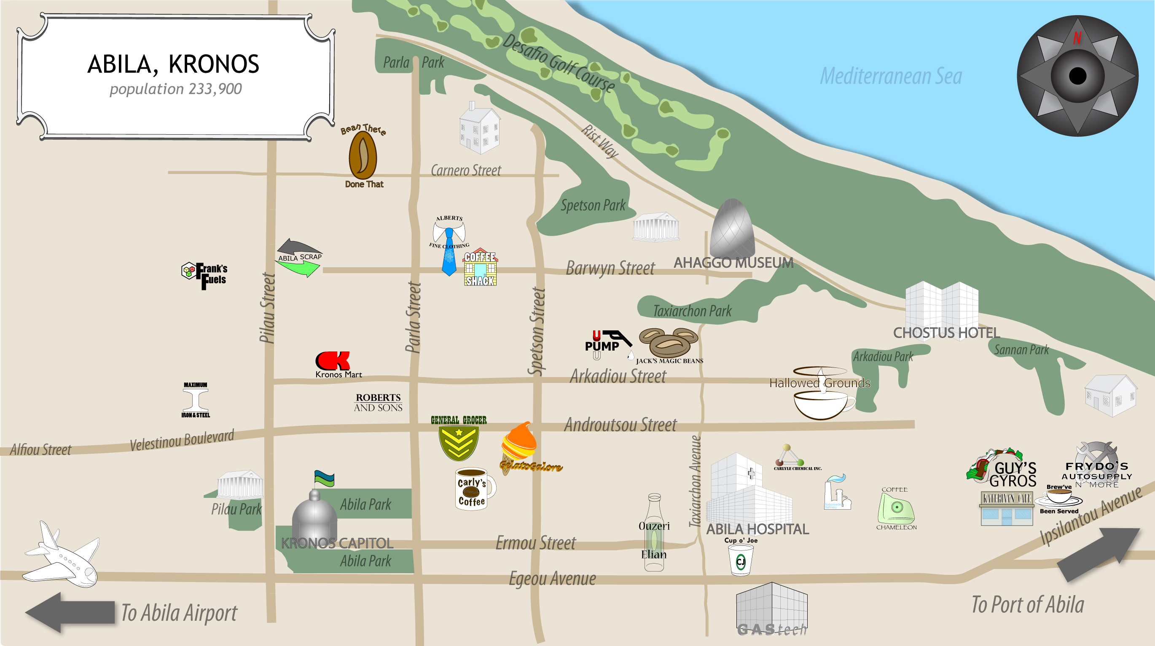

Slide 6
Goal #1: A Day In The Life
A typical day involves a lot of driving around the city. Employees go from home to work, stop at coffee shops around the city, and drive to other locations as needed.

Slide 7
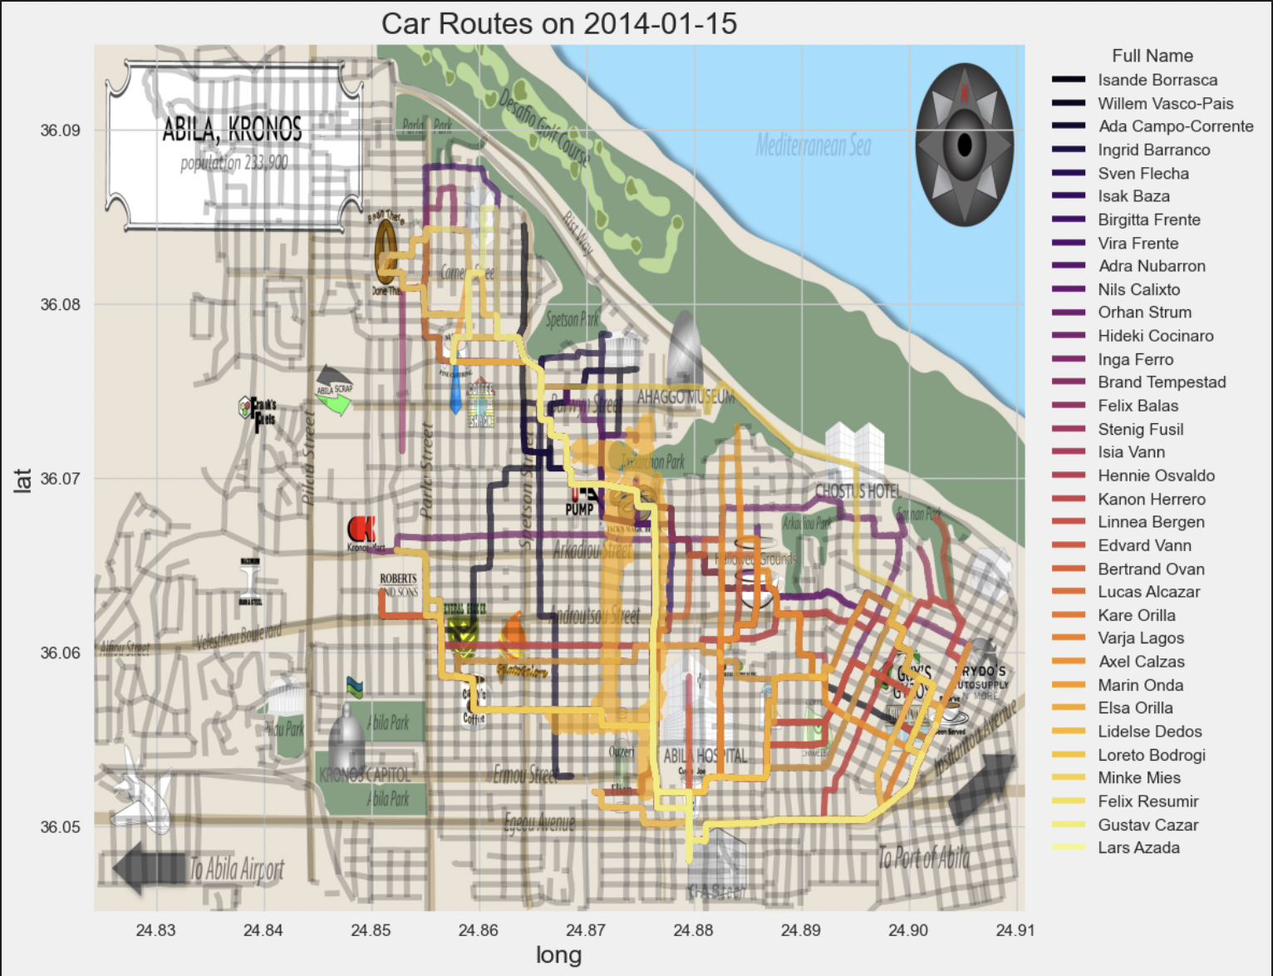
A Typical Day

Slide 8
Goal #2: Identify 12 Unusual Patterns

Slide 9
Pattern 1: There are identical charges for Elsa Orilla and Kanon Herrero at Kalami Kafenion on 1/7 and Ahaggo Museum on 1/18

Slide 10
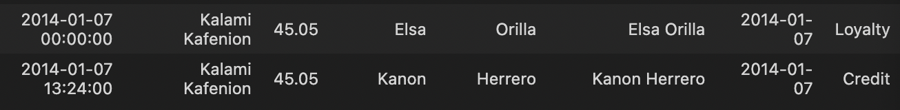
Pattern 1 cont.
GPS data confirms the fact that these two employees were in the same locations at or around the times of the charges
They use one person’s credit card and one person’s loyalty card
Neither of them were anywhere close to the museum until 4 hours after the transaction was recorded

Slide 11
Patterns 2: Truck drivers visit same unmarked locations and are involved in large transactions
Notes:
There are 5 unmarked vehicles in our data. These vehicles frequently visit the airport, refinery, chemical plant, steel plant and 2 unmarked locations.

Slide 12
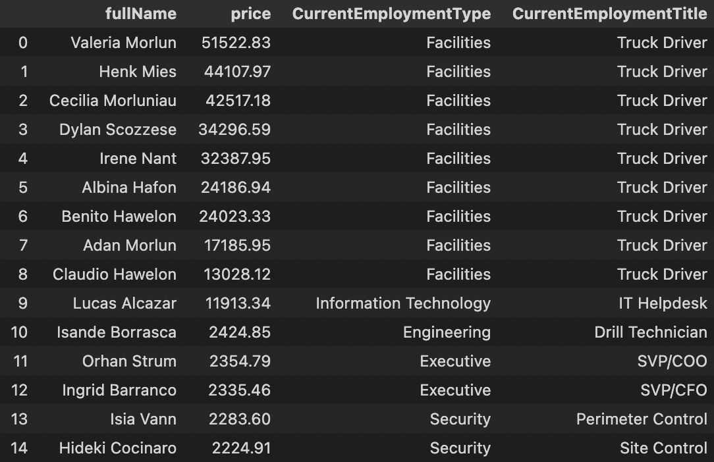


Top 15 Spenders
The truck drivers spend more than the executives​
Notes:
The truck drivers spend more than the executives

Slide 13
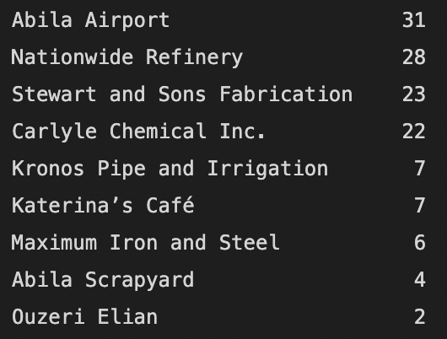
Truck Driver Transaction Counts
Transactions take place at strange locations

Slide 14
Investigate Truck Data
There are 5 unmarked vehicles in our data. These vehicles frequently visit the airport, refinery, chemical plant, steel plant and 2 unmarked locations.
GAStech employs 9 Truck Drivers without designated vehicles

Slide 15
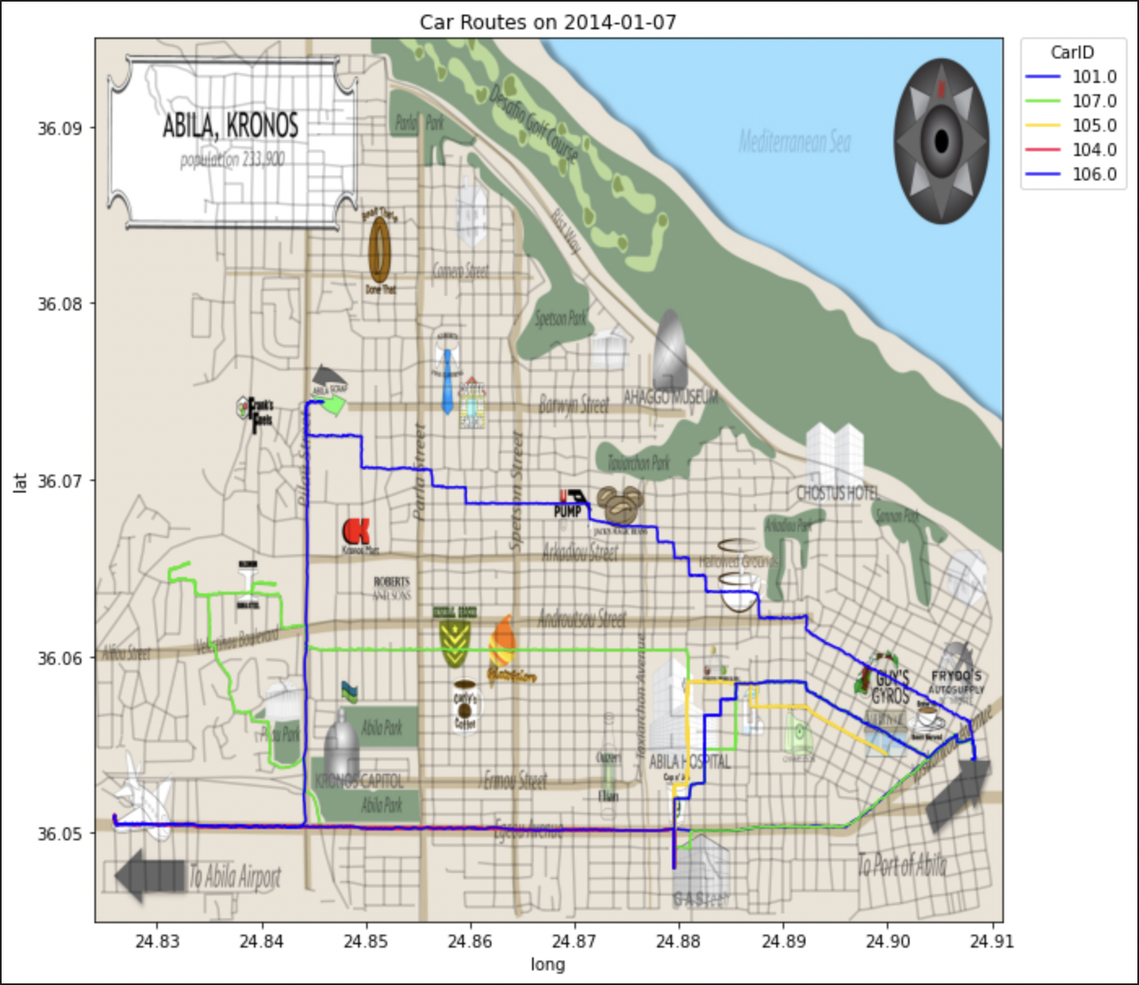
Example Routes of Unmarked Cars

Slide 16
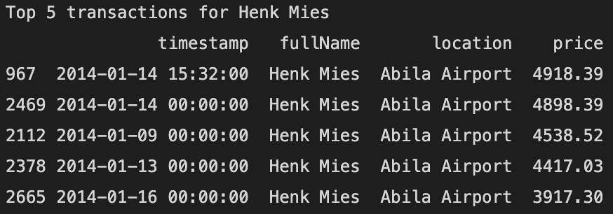
In spot checking the transaction dates, we do see unmarked cars visiting the locations on those days

Slide 17
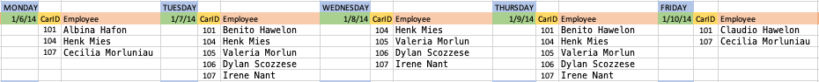
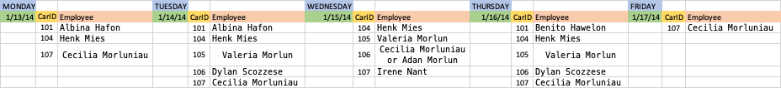
Identifying Truckers
Truck Drivers with only 1 day of transaction info: (Claudio Hawelon on 1/10 & Adan Morlun on 1/15)
Valeria Morlun & Henk Mies are the only truck drivers with their own designated vehicles
Notes:
Locations of truck driver’s transactions seem to align with the routes of the unmarked cars

Slide 18




Assumptions
Suspected members of the terrorist organization include GAStech employees on Kronos Island
The only employees that are not assigned a car are truck drivers
Employees are not aware of the tracking device on their vehicles and do NOT share vehicles
Provided map has the names and locations of ALL businesses involved in the investigation

Slide 19
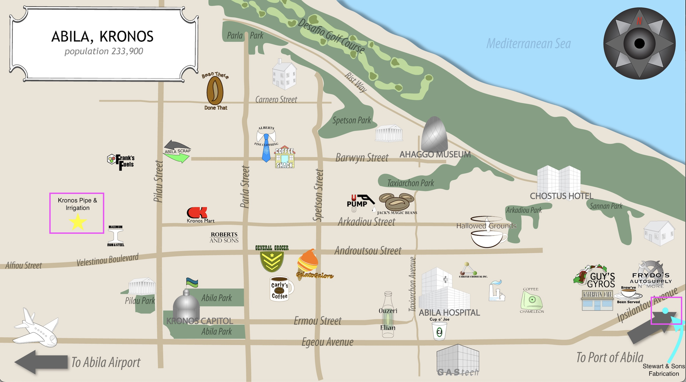

Slide 20
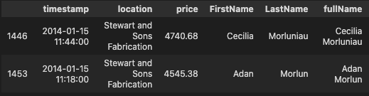
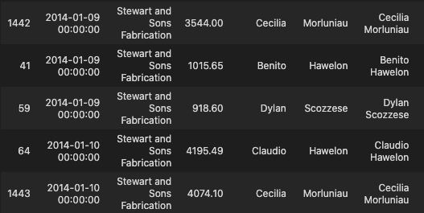


















Slide 21
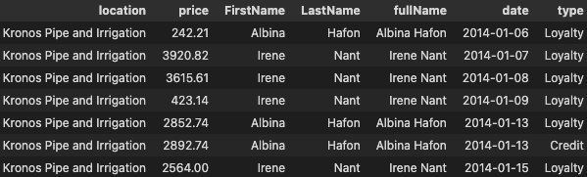
Out of the 7 days that either Irene or Albina are driving a truck, Albina does NOT make a transaction at Kronos Pipe and Irrigation on 1/14 after charging a transaction on his credit card.

Slide 22
Patterns 3: Truck drivers make repeat large transactions through loyalty cards at locations of interest

Slide 24
Pattern 4: Brand and Isande have recurring purchases at the hotel on the same dates.

Slide 25
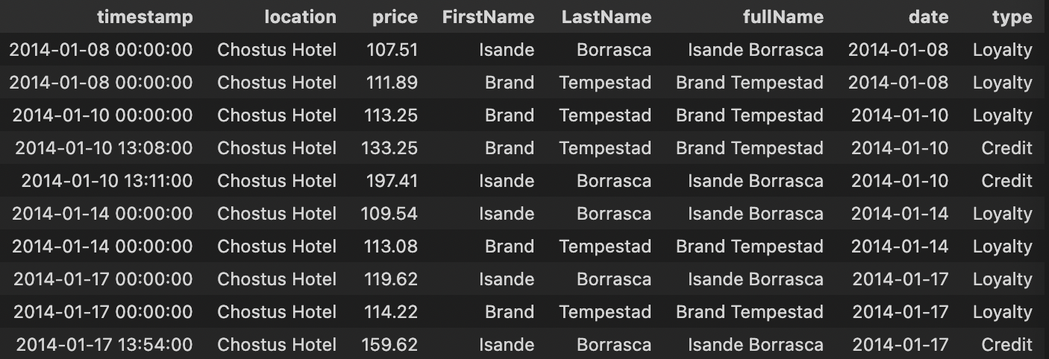
Pattern 4 cont.
GPS data confirms the fact both of them were present at the hotel on these dates

Slide 26
Pattern 5: Cecilia and Irene share transactions with other truck drivers on dates they do not have vehicles designated to them.

Slide 27
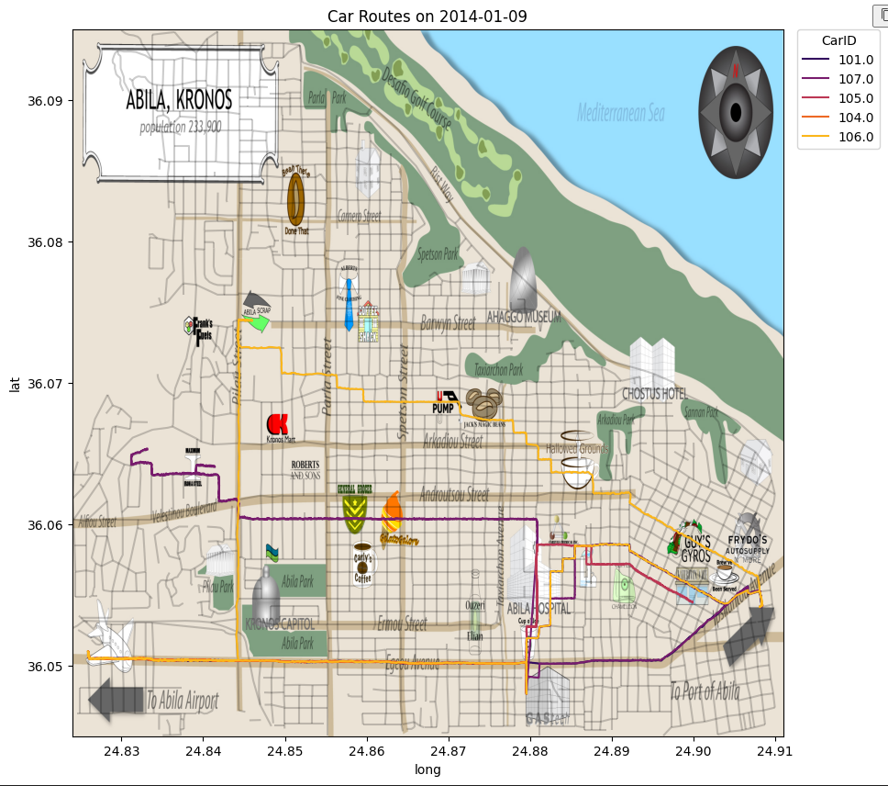
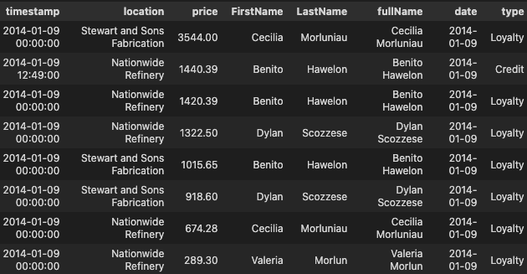
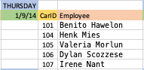
Cecilia's Shared Transactions

Slide 28
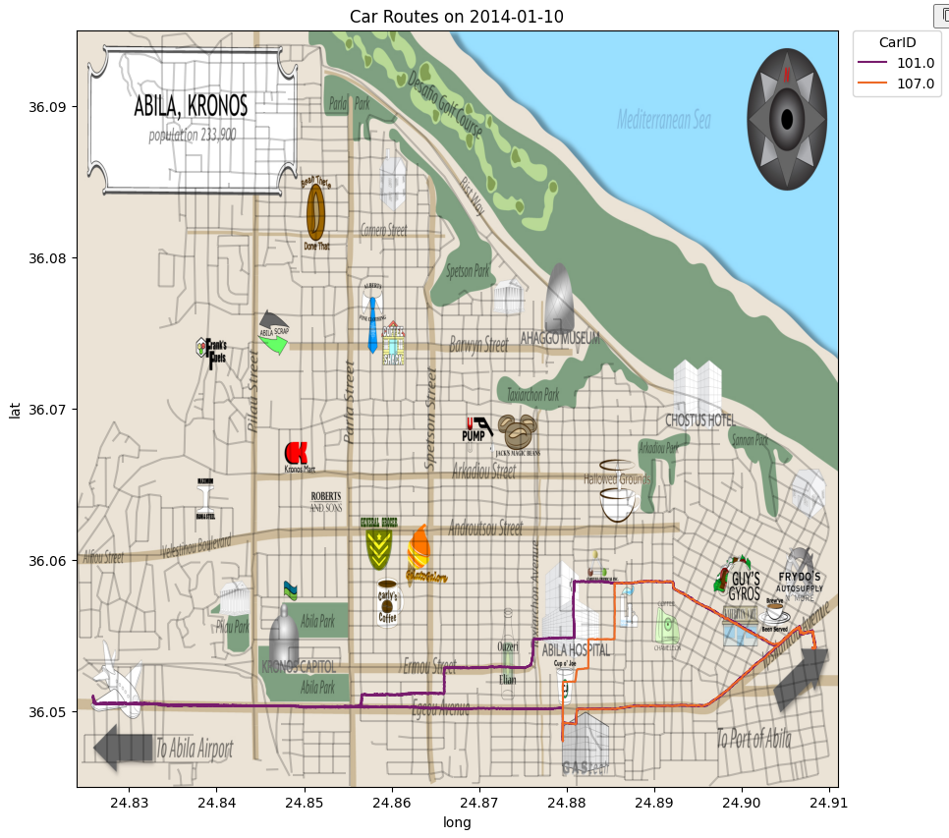
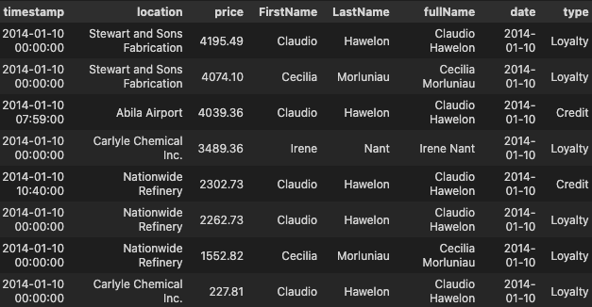
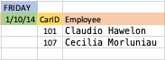





Irene's Shared Transactions

Slide 29
Pattern 6: Many employees seem to be at GAStech after hours

Slide 30
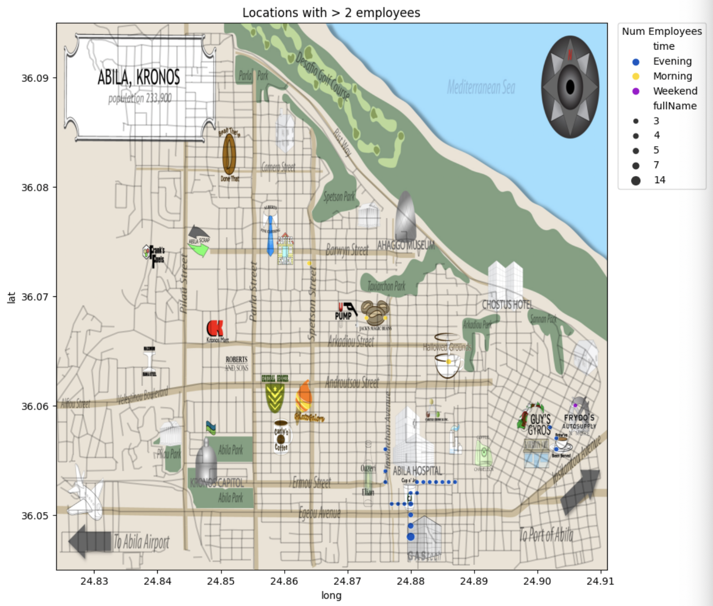
Employee Locations

Slide 31
Pattern 6 cont.
By cross referencing which employees were registered to the cars that were at GAStech after hours, we see employees from all across the company, including executives
One unmarked car was present as well

Slide 32
Pattern 7: 2 employees are in a residential area above Carnero St. in the morning hours

Slide 33
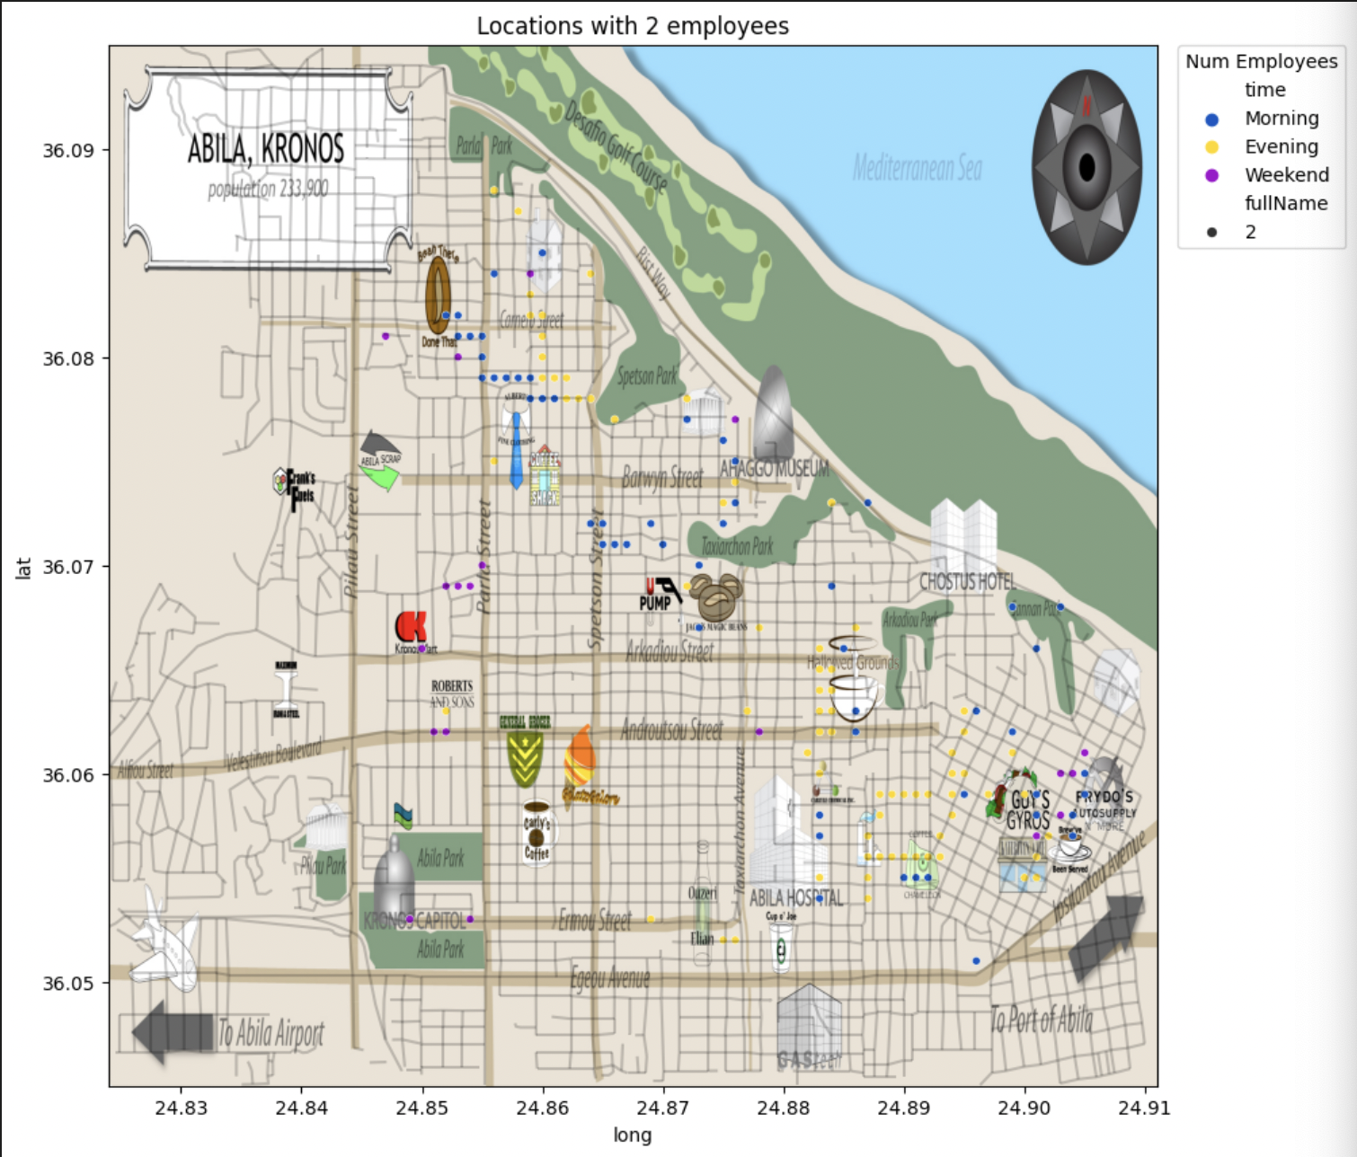
Employee Locations

Slide 34
Pattern 7 cont.
By drilling into our GPS data, we see 2 employees present at the same time in the early morning hours

Slide 35
Pattern 8: 2 employees were together at the Capitol on the Weekend

Slide 36
Employee Locations

Slide 37
Pattern 8 cont.
It is strange for employees to visit government buildings together
2 other employees also visited the Capitol on the same day, but at different times

Slide 38
Pattern 9: Employees frequently visit the hotel on the same dates

Slide 39
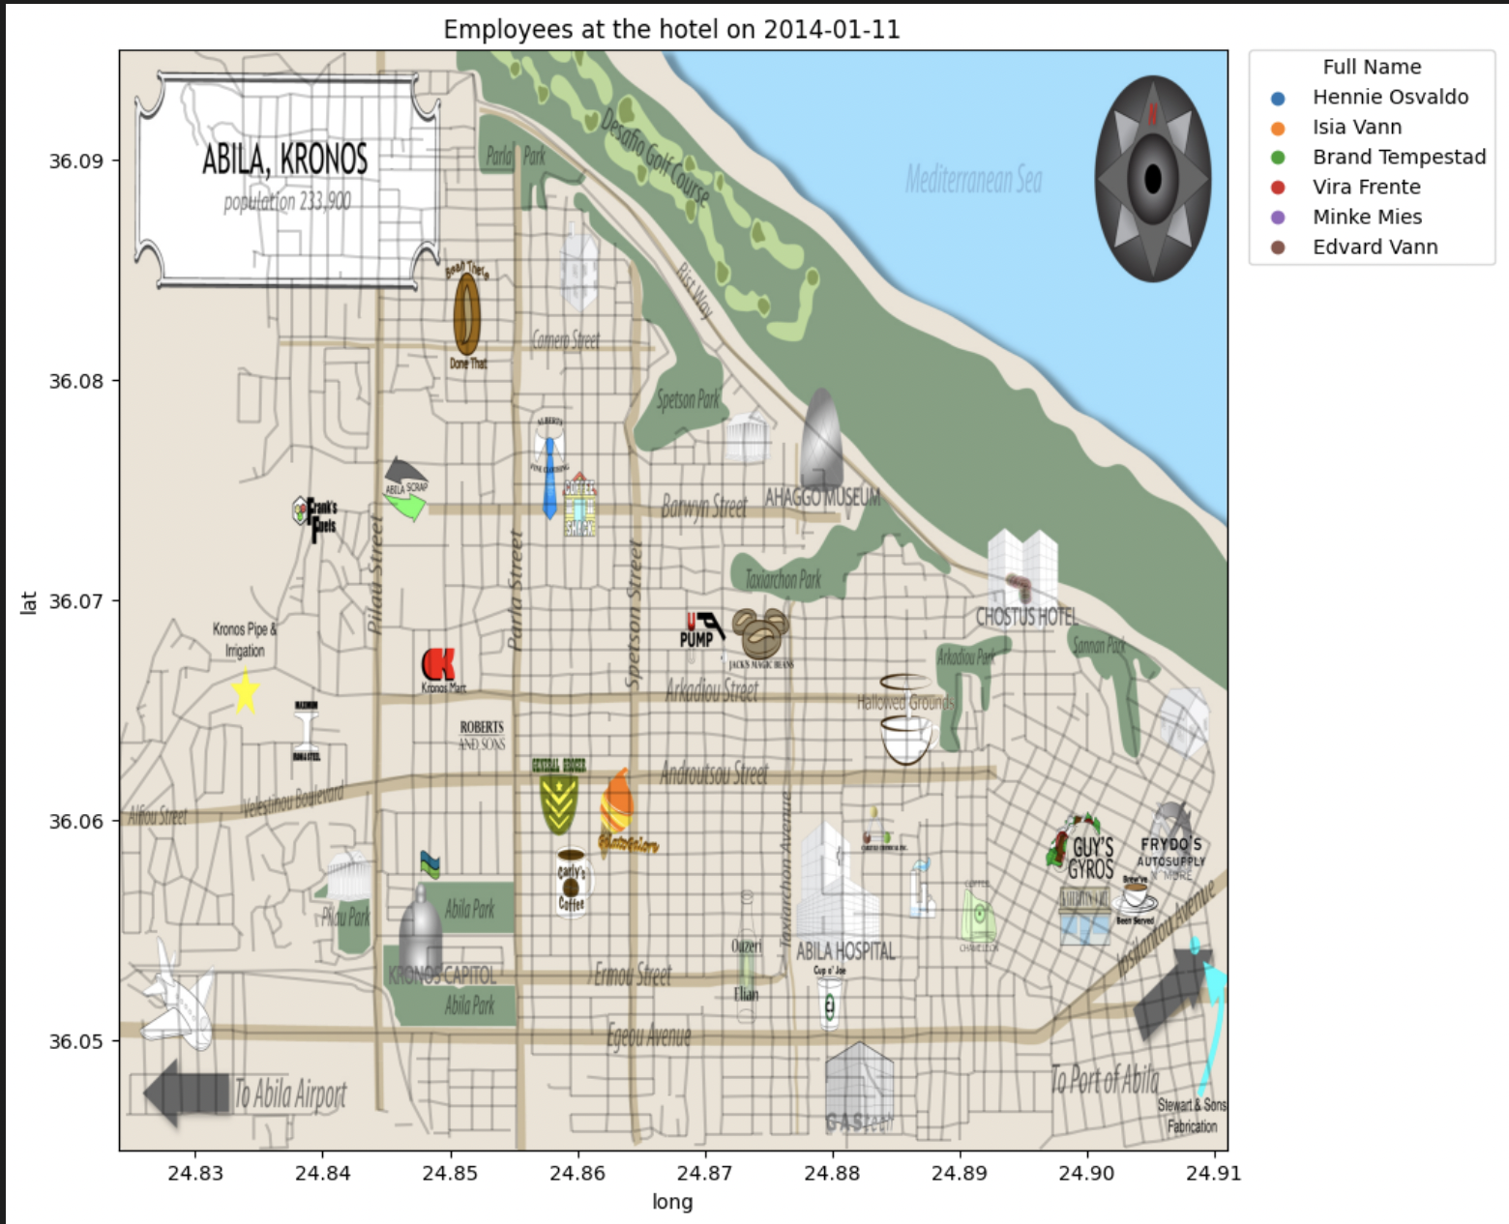
Example Day at the Hotel

Slide 40
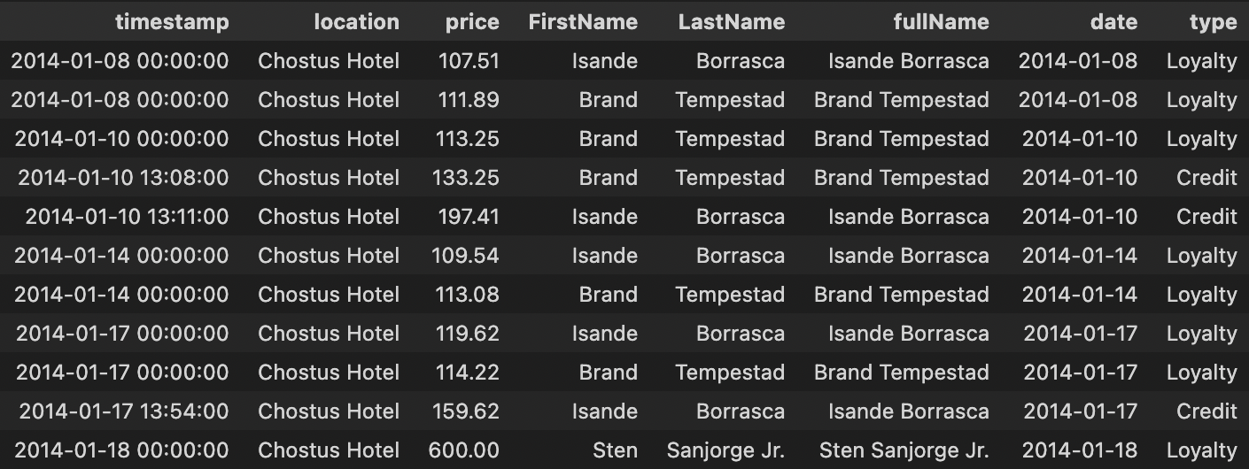
Pattern 9 cont.
Most of the employees present at the hotel have no transactions there

Slide 41
Pattern 10: Loreto Bedrogi and Felix Balas are the only ones with GPS data at the scrapyard but all transactions are under Dylan Scozzese's name.

Slide 42
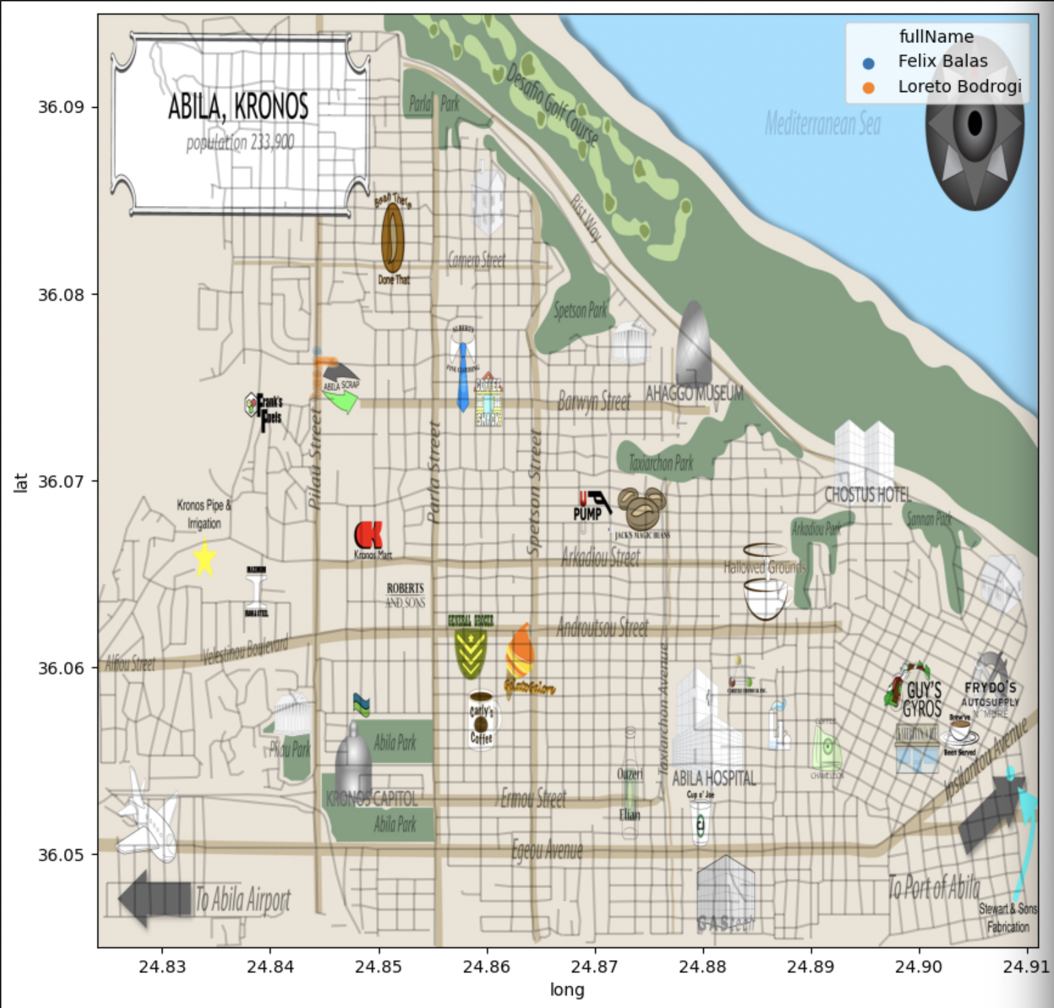
Scrapyard Visitors

Slide 43
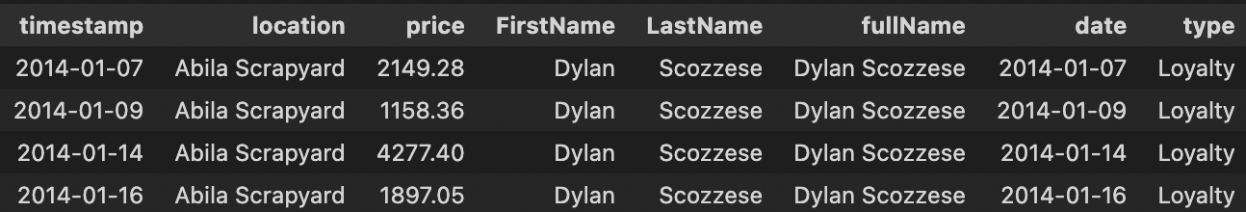
Pattern 10 cont.
Either Felix and Loreto are using Dylan’s account, or Dylan is a passenger when they visit

Slide 44
Pattern 11: There are groups of employees who meet regularly at coffee shops. One person takes turns paying each day.

Slide 45
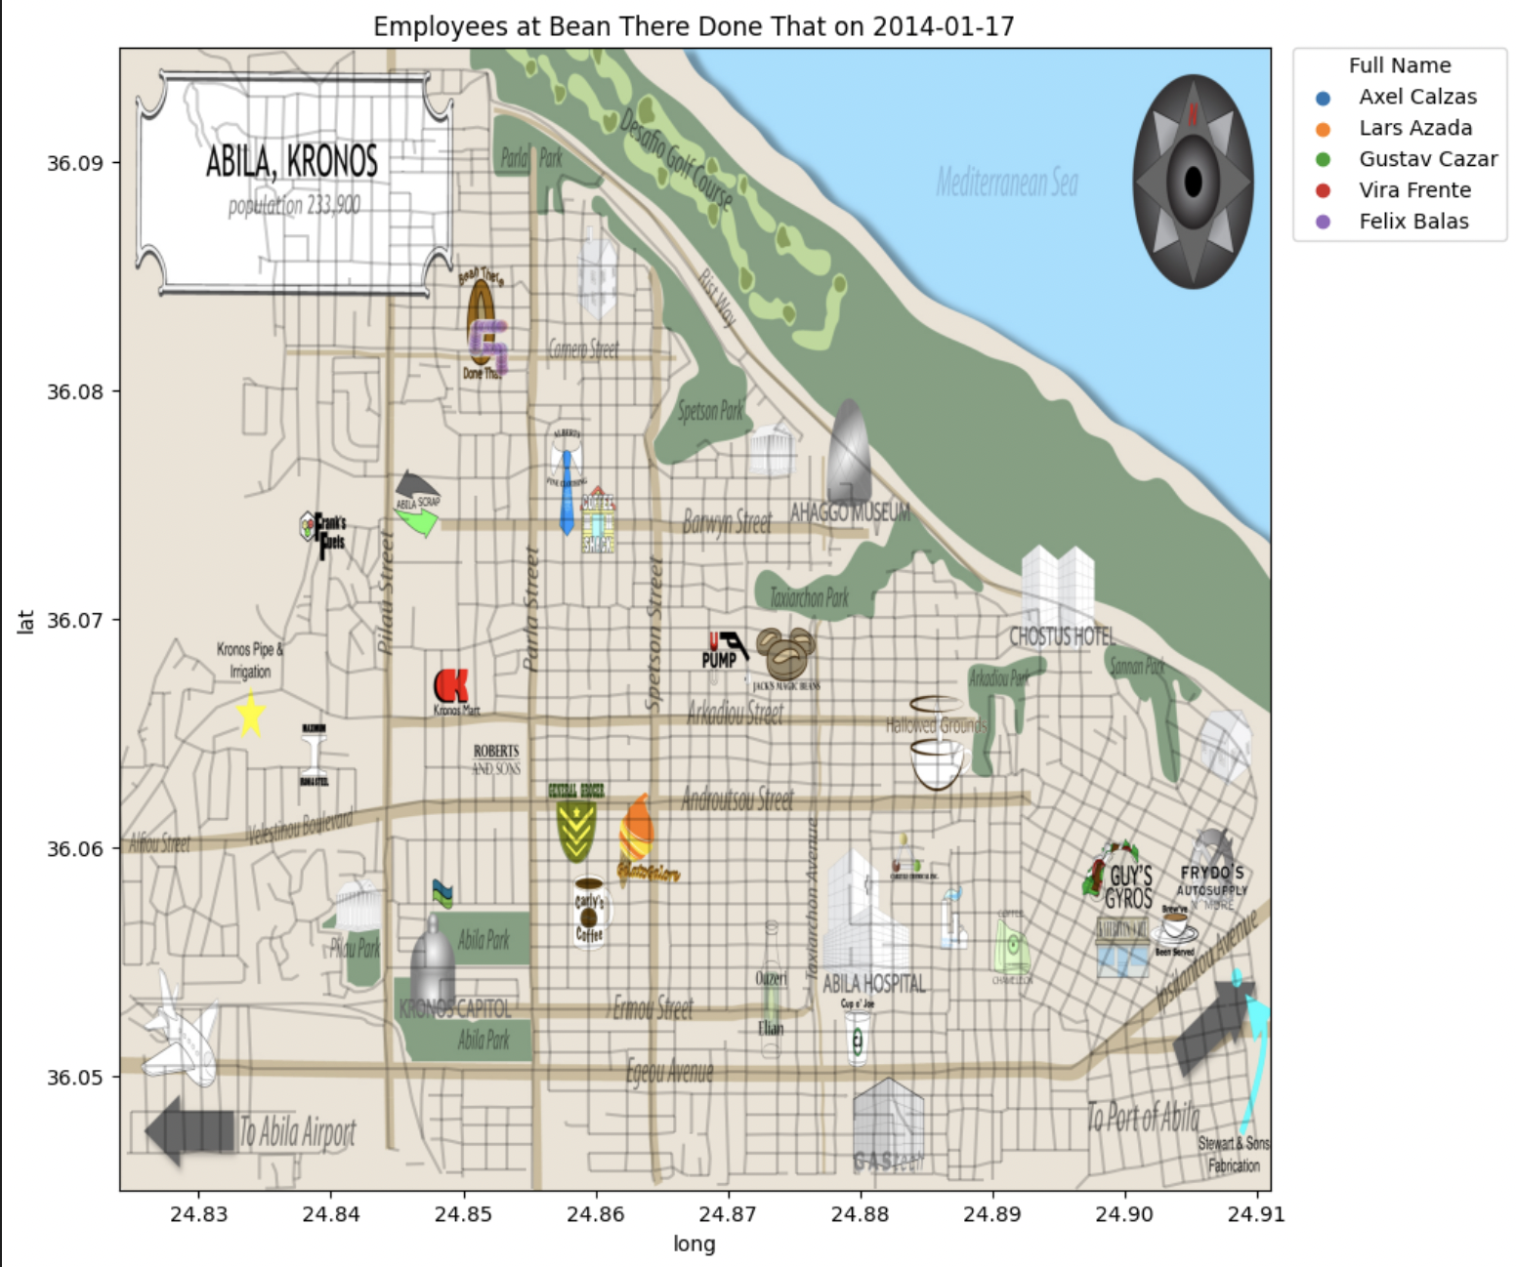
Example Day at Bean There Done That

Slide 46
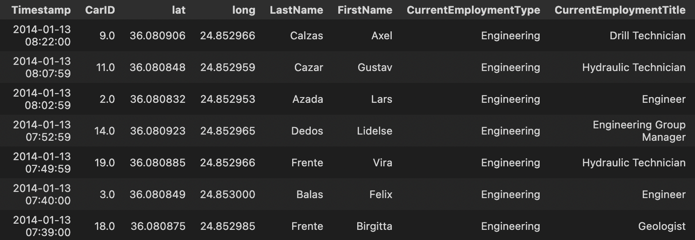
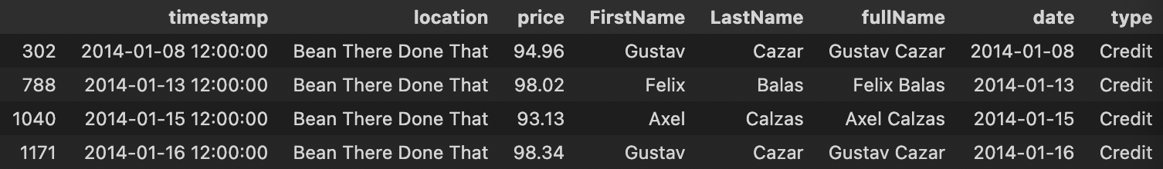
Pattern 11 cont.
These are very unusual transactions for a coffee shop.

Slide 47
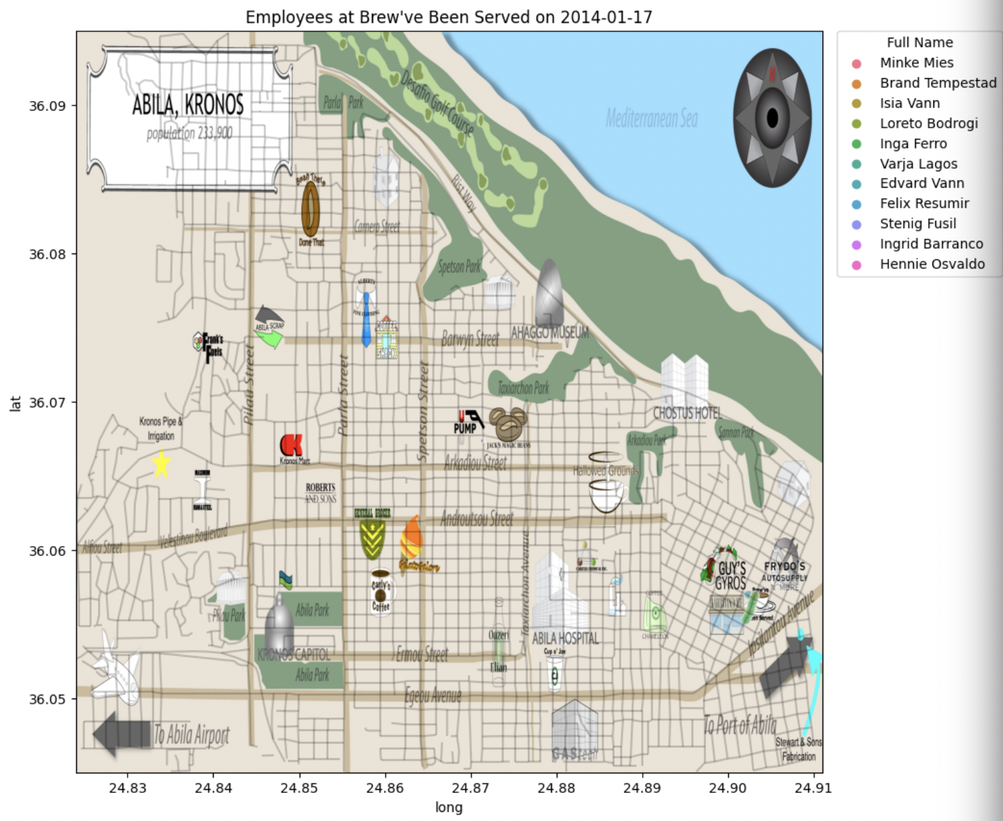
Example Day at Brew’ve Been Served

Slide 48
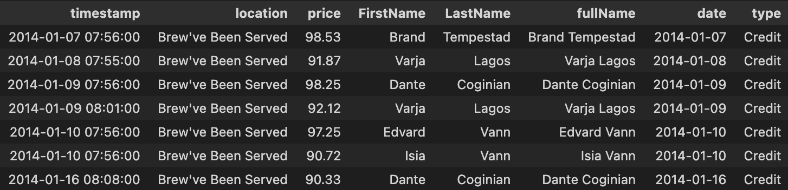
Pattern 11 cont.
These are unusual transactions for a coffee shop

Slide 49
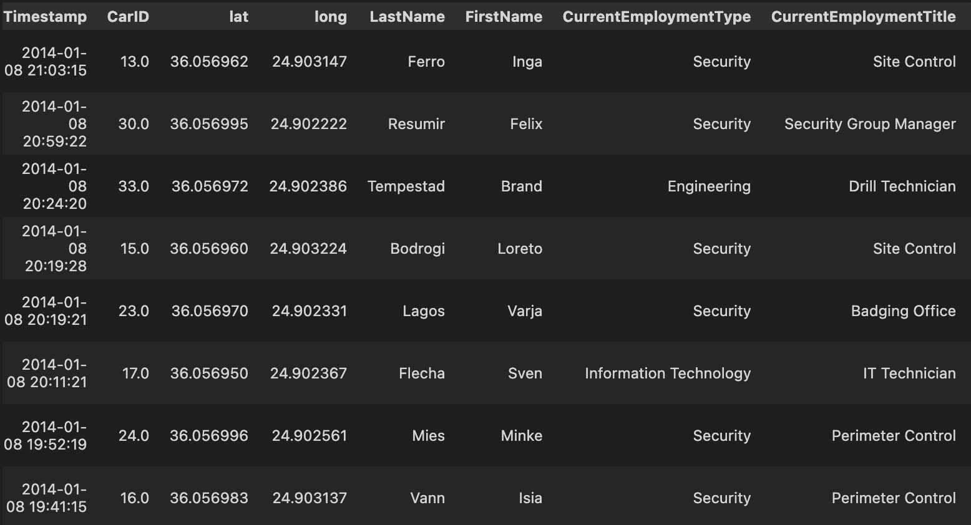
Pattern 11 cont.
They seem to be present at unusual hours

Slide 50
Pattern 12: Elsa Orilla never goes to GAStech

Slide 51
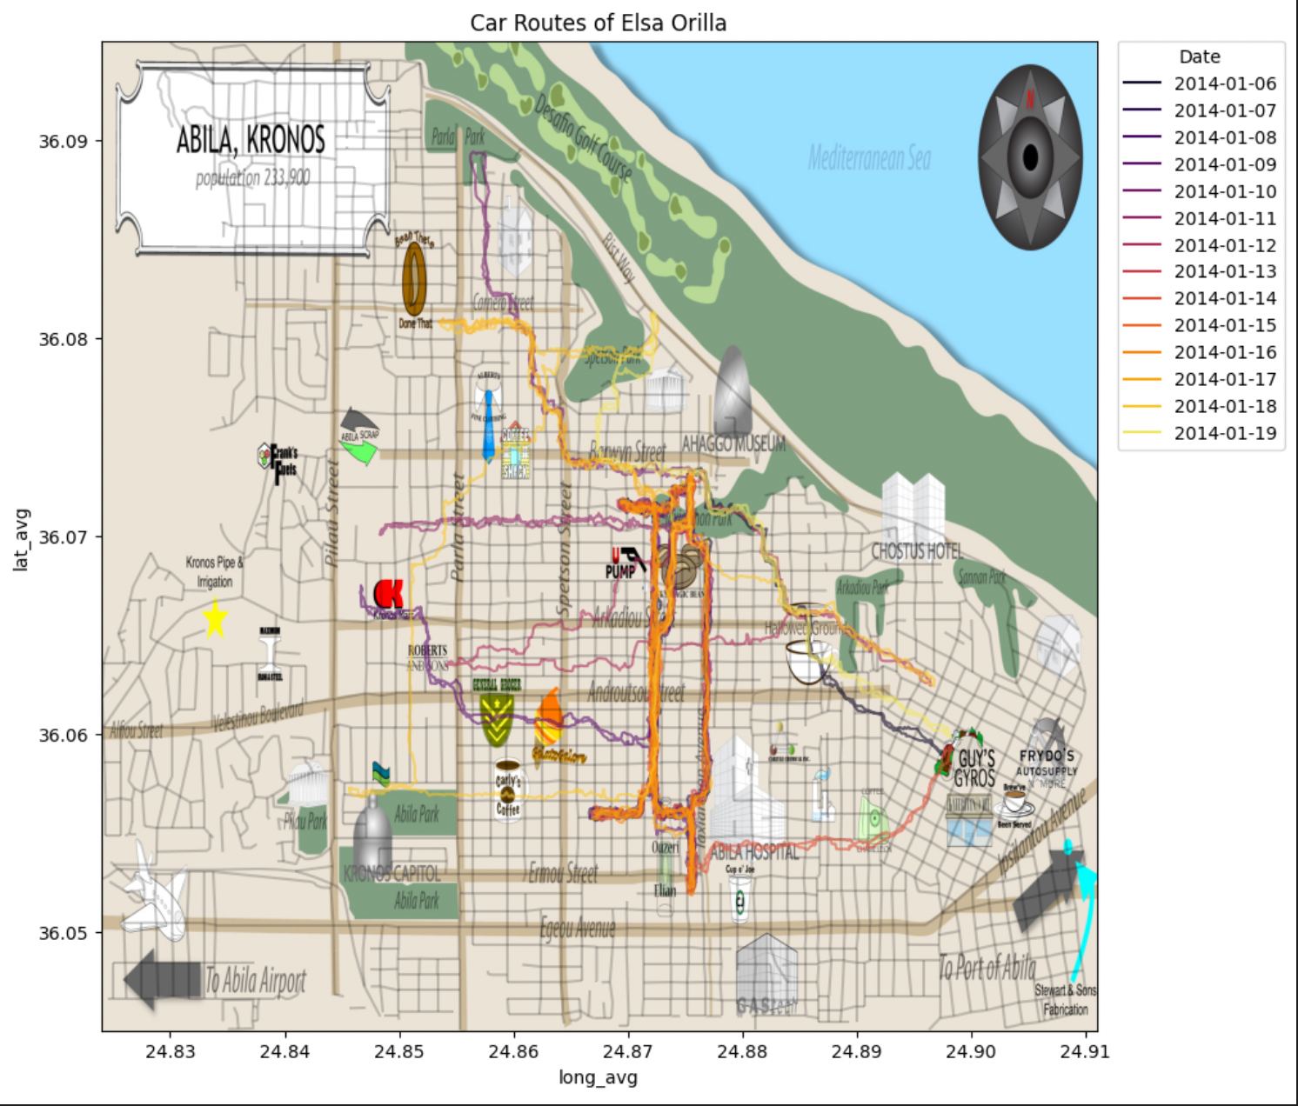
Elsa’s Car Routes

Slide 52
Conclusions
In the strange behavioral patterns of the employees, a few names seem to come up regularly
While any one individual pattern can be justified, together the employees of GAStech are behaving very strangely
We recommend that investigators dive more deeply into the lives of the employees as this is likely an inside job

Slide 53
Future Suggestions
Additional suggested data:
Airport log of people and materials
Inventory log of Truck transport
Employee personal vehicle data
Transaction data on local population
Month-long data instead of just 2 weeks
Assumptions cannot be relied upon:
Transaction data suggests individuals were sharing vehicles
Two Hidden locations were discovered and added to the map

